Slide 1
QR decomposition
Gyanesh kumar Pandey

Slide 2
QR decomposition
A program to solve a system of linear equations Ax=b using QR decomposition

Slide 3
INTRODUCTION
QR Decomposition with Gram-Schmidt Igor Yanovsky (Math 151B TA) The QR decomposition (also called the QR factorization) of a matrix is a decomposition of the matrix into an orthogonal matrix and a triangular matrix.
A QR decomposition of a real square matrix A is a decomposition of A as A = QR, where Q is an orthogonal matrix (i.e. QTQ = I) and R is an upper triangular matrix. If A is nonsingular, then this factorization is unique.
One advantage of QR decomposition over LU decomposition is that this method does not require that the decomposition be carried out on a square matrix. QR decomposition results in factoring matrix A (having independent columns) into the product of two matrices, namely Q and R:

Slide 4
Python
Input for the program Q and R and b
A program to solve a system of linear equations Ax=b using QR decomposition logic of Python code would involve the following steps:
1. Import the NumPy library.
2. Define the matrix A and vector b.
3. Use the QR decomposition function to decompose matrix A.
4. Use the solve function to solve the system of linear equations.
5. Print the solution vector x.

Slide 5
Python
Input for the program Q and R and b
A program to solve a system of linear equations Ax=b using QR decomposition logic of Python code would involve the following steps:
1. Import the NumPy library.
2. Define the matrix A and vector b.
3. Use the QR decomposition function to decompose matrix A.
4. Use the solve function to solve the system of linear equations.
5. Print the solution vector x.

Slide 6
How to use Python LIB
Although there is a way to hand-calculate the matrices Q and R (e.g., using the Gram-Schmidt process), we will rely on computation. To carry out a QR decomposition in R, we will use the qr() function which factors the matrix and returns a list of output related to the QR decomposition. To extract the actual Q and R matrices from this output, we will use the qr.Q() and qr.R() functions, respectively.

Slide 7
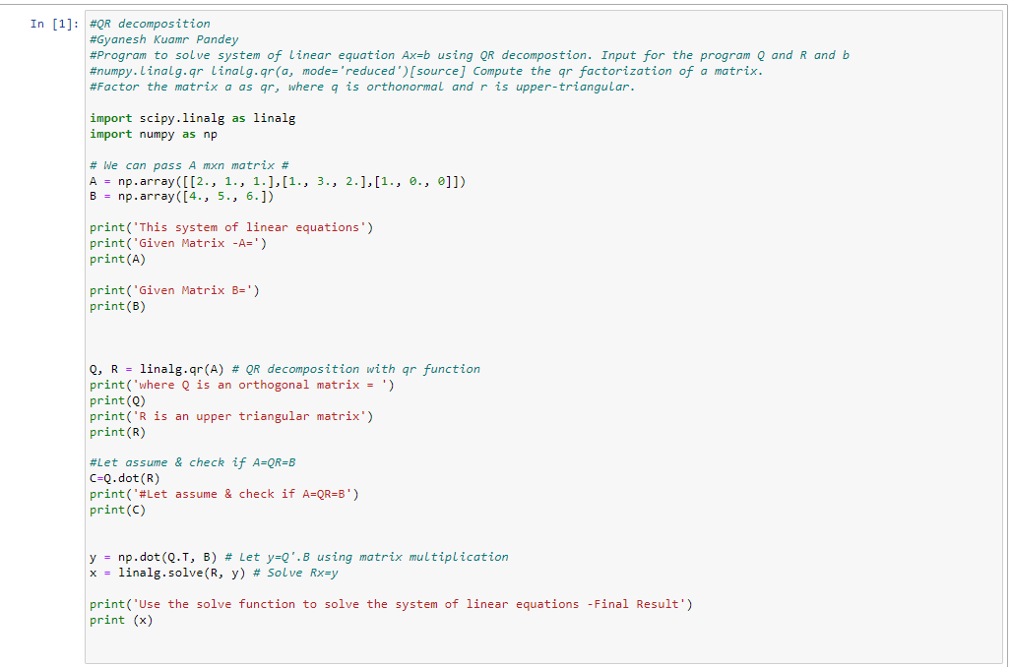

Slide 8
THANK YOU
Gyanesh Kumar Pandey

